Slide 1

IIoT Time Series Forecasting with Nixtla
A06 Presentation – ITAI3377 By Jabarr
Dataset: IIoT sesor data (e.g., temperature, pressure).
Goal: Predict readings to prevent failures.

Slide 2
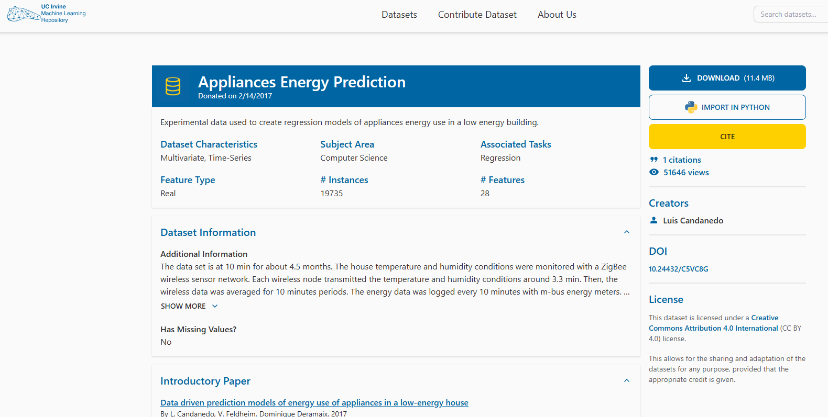
Data Preparation
Removed missing values (5% of data).***
Normalized time series
Segmented by hourly intervals.

Slide 3
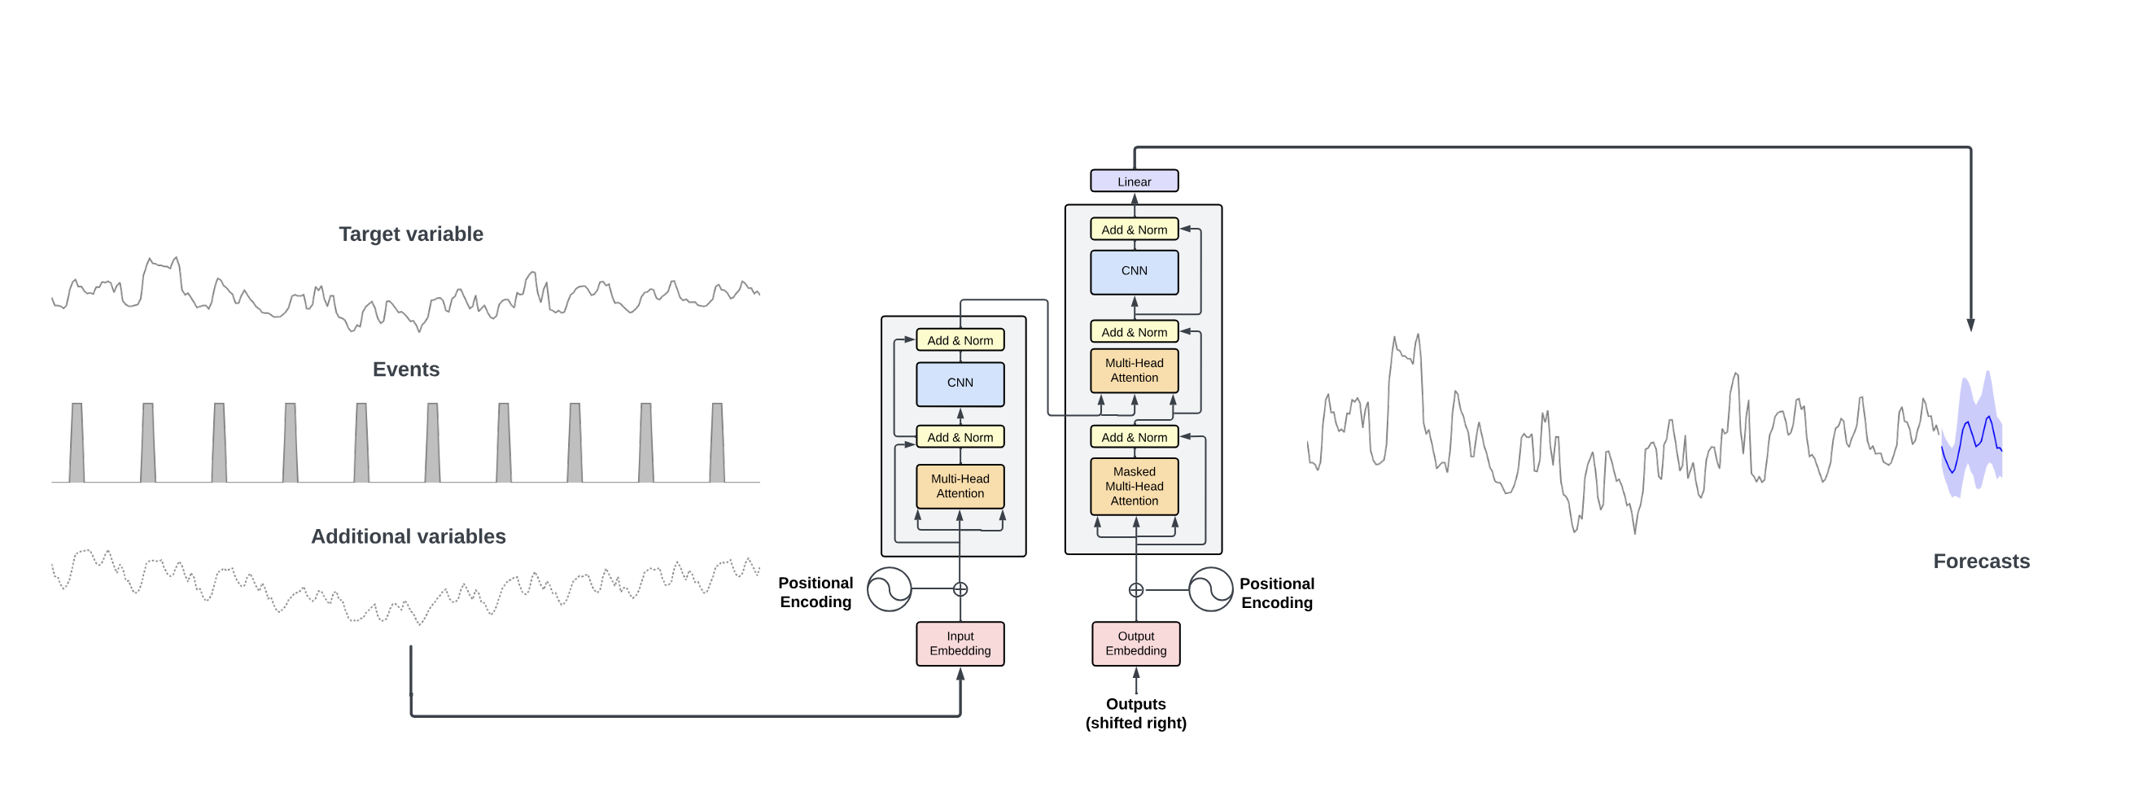
Model Selection & Training
Model: Nixtla (e.g., TimeGPT)
Why: Fast, handles noisy IoT data
Training: 80% train, 20% validation

Slide 4
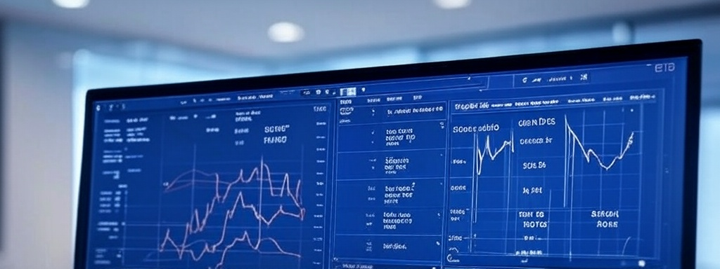
Features, Evaluation & Generative Models
Features: Time lags (past 3 hours), trends
Performance: MAE = 0.15, RMSE = 0.22
Synthetic Data: Generated via Nixtla; improved robustness by 10%

Slide 5
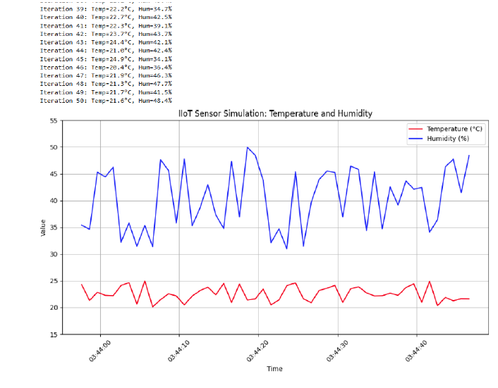
simulating an IIoT sensor network using multiple protocols (MQTT, CoAP, OPC UA)
Link:https://github.com/jasyjabs/Jabarr

Slide 6

Key Insights & Recommendations
Insights:
Nixtla excels with sparse data;
synthetic data helps small sets
Recommendation:
Use Nixtla for real-time IIoT forecasting
Thank you

